Slide 1
WealthifyMe
Financial smarts, at your fingertips.
$
Team: Kamya Krishnan Samruddhi Chaudhari
Sayali Borate Asawari Kadam
Notes:
Hello Everyone, we are here to present our Project. I am Asawari and I have Kamya, Sayali, Samrudhhi here with me. So, currently in the market, there are so many apps which will make your life easier but will make you lazy as well. I am about to graduate and I still have to google what liquidity is. We need something which makes us financially advanced as well. That’s why we bring WealthifyMe.

Slide 2
Table of contents
01
04
02
05
03
06
Introduction
Features
Objectives
Algorithms
Project Overview
Demo
Notes:
This is our our overview. We will start with Introduction , objectives, and then will slowly move into Demo.

Slide 3

Introduction
Financial literacy plays a crucial role in empowering individuals to make informed financial decisions. However, understanding financial terms can be challenging for many people due to their complexity and technical nature. Our project aims to address this issue by developing a financial literacy chatbot that simplifies financial concepts and makes information accessible to everyone.
Notes:
We all are educated, but not necessarily financial literate. There is a lot of information available online but structured information is difficult to look for and even harder to get. So our project aims to address this problem by employing our chatbot. It will get you all and the accurate information in seconds and will give you suggestions as well.

Slide 4
Objectives
To build an intelligent chatbot that helps users understand financial terms in simple language.
To provide quick, accurate, and reliable answers to financial queries.
To bridge the gap between technical financial jargon and users with little or no financial knowledge.
To promote financial awareness and literacy among individuals.
$
$
Notes:
So when we started this project our objectives were to build a self-sufficient chatbot that will help users in understanding financial terms in simple language and with simple real life scenarios. Also, we wanted to provide quick, reliable answers to all of our users. Also, the ultimate goal always was to promote financial literacy and awareness among all individuals.

Slide 5
Challenges to Understand Financial Terms
Financial Jargon Barrier
Lack of Universal Definitions
Financial language is often complex and difficult for non-experts to comprehend.
Financial definitions can vary across regions and institutions.
Contextual Ambiguity
Complex Financial Articles
Many terms have ambiguous meanings depending on the context while different financial terms might have similar meanings, causing confusion
Financial documents and articles are large and difficult to understand.
Notes:
As I mentioned before, there are numerous challenges to understand the financial terms. Because there are often too complex for the outsiders and their definitions may vary across places. Also, these terms have contextual ambiguity where their meaning will totally depend on the given context and will vary. Also, we cant rely on Financial Articles as they are quite large and difficult to understand.

Slide 6
Project Overview
Features:
Agentic Approach
Intent recognition
Simplifies financial terms and explains jargon
Recommends resources and follow-up learning questions
Real-time stock prices and market data
Summarization of financial documents
Technologies Used:
Python Libraries: spaCy, yfinance
FAISS for efficient similarity search and retrieval
Streamlit framework for chatbot interface
OpenAI's GPT-4 and embedding models
NLP methods: Named Entity Recognition
Notes:
So, these are our features , we have followed Agentic Approach, we have used Intent Recognition, Our chatbot Simplifies financial terms and explains jargon, It also Recommends resources and follow-up learning questions, displays Real-time stock prices and market data, and provides Summarization of financial documents.
We have used spaCy, yFinance here. YFinance retrieves real-time stock and market data for us. FAISS for efficient similarity search and retrieval. We have also used streamlit for interface. OpenAI's GPT-4 turbo and embedding models are used for query understanding, intent classification, and generating financial insights

Slide 7
AI Agents
Types of Agents in WealthifyMe:
Intent Recognition Agent: Classify user queries into predefined categories
Data Retrieval Agent: Fetch relevant financial or market data
Summarization Agent: Condense lengthy financial reports or news
Recommendation Agent: Suggest investment strategies or learning resources
Verification Agent: Validate retrieved definitions and ensure accuracy; generate new responses if no suitable match is found
Notes:
To power the different features, we are using AI agents that perform tasks autonomously by processing user input, retrieving relevant data, and providing insights or recommendations.
Wealthify Me has an Intent Recognition Agent which Classifies user queries into predefined categories such as market data, comparison, definition, and so on
The Data Retrieval Agent Fetches relevant financial data, stock prices, or economic indicators from sources like Yahoo Finance.
The summarization Agent Condenses lengthy financial reports or news articles into concise summaries using AI-based summarization models.
The recommendation Agent Suggests investment strategies, or learning resources based on historical data and forecasting models.
Verification Agent: Validate retrieved definitions and ensure accuracy; generate new responses if no suitable match is found.

Slide 8
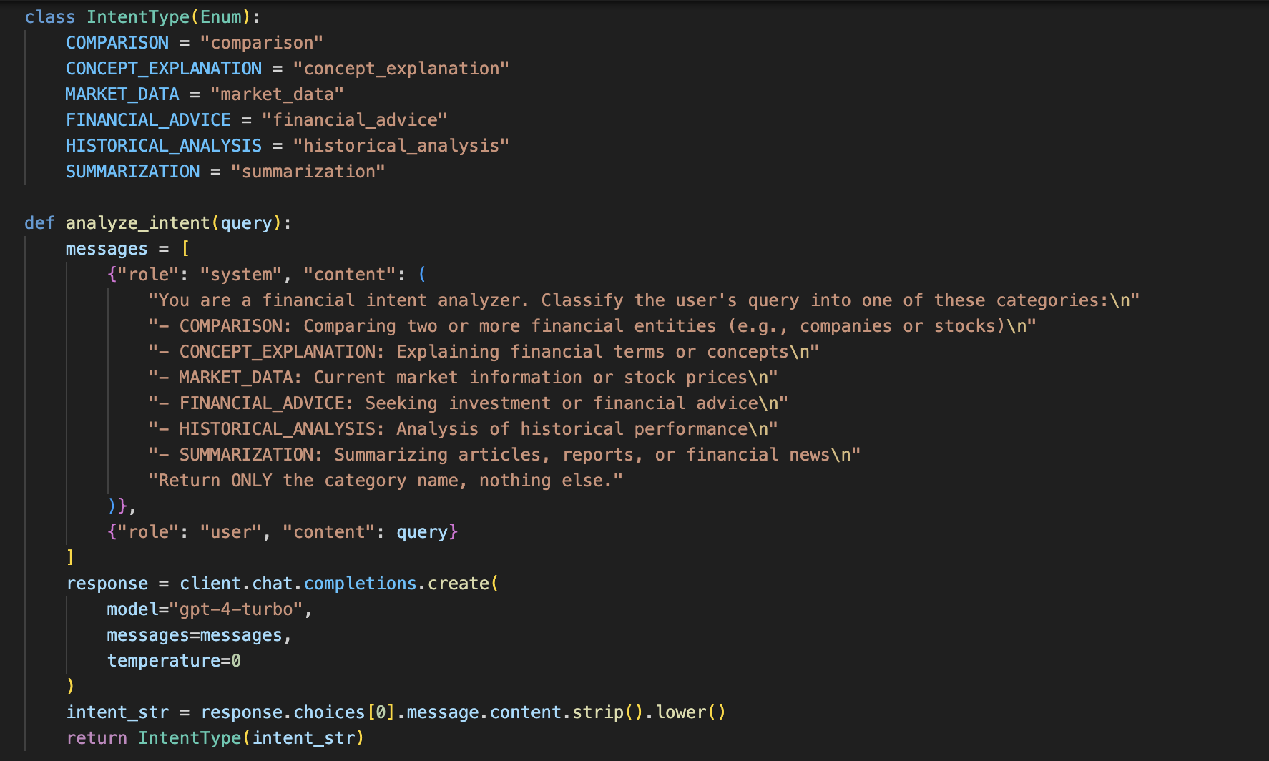
Intent Recognition
Intent classification helps categorize user queries into specific financial intents
Common financial intents include:
Comparison (e.g., comparing stock performance)
Concept Explanation (e.g., defining financial terms)
Market Data (e.g., fetching stock prices)
Financial Advice (e.g., investment guidance)
Historical Analysis (e.g., past performance trends)
Summarization (e.g., summarizing financial articles)
Notes:
We are using intent recognition in order to better understand the user’s requirement allowing AI systems to provide relevant and accurate responses
We’ve used 6 intent classes:
Comparison Identifies when users want to compare financial instruments like stocks.
Example: "How does Apple stock compare to Microsoft?"
Concept Explanation Detects when users seek definitions or explanations of financial terms.
Market Data Recognizes queries related to real-time stock prices
Financial Advice Classifies requests for investment strategies.
Example: "Should I invest in tech stocks right now?"
Historical Analysis: Identifies queries about past stock performance, trends, or historical returns.
Summarization: Detects when users want a condensed version of financial reports or news.

Slide 9
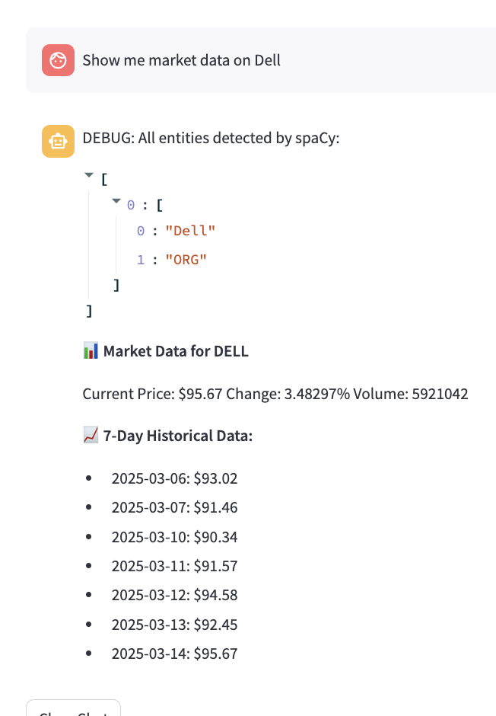
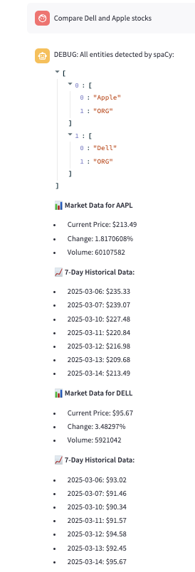
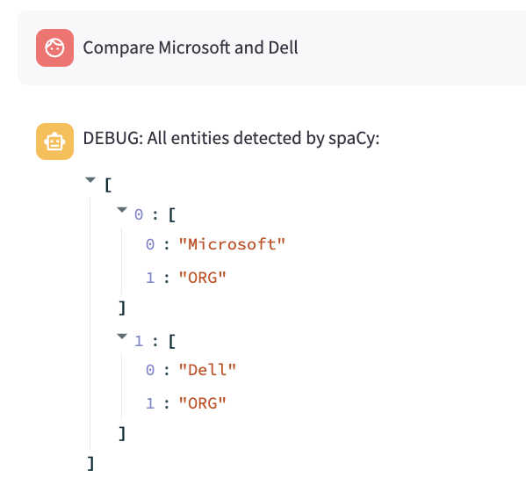
Market Data
Users can input a company name to retrieve and compare stock prices.
The chatbot identifies the company and finds its stock ticker using NER (Named Entity Recognition).
It fetches real-time and historical stock prices using OpenAI API and yfinance.
The chatbot provides comparisons and insights on stock performance.
Notes:
When users want to view market performance of companies or compare stock performance of different companies, the system will classify the intent as either historical, comparison or market data. The chatbot will use Named Entity Recognition (NER) to identify the company and using a dataset which contains a mapping of company and ticker symbol will extract its stock ticker symbol. Using the stock ticker, the chatbot fetches both real-time and historical stock prices using yfinance and uses OpenAI API to provide users with detailed comparisons of the company's stock performance, offering insights into trends, historical data, and current stock value, helping users make more informed decisions or analysis.

Slide 10
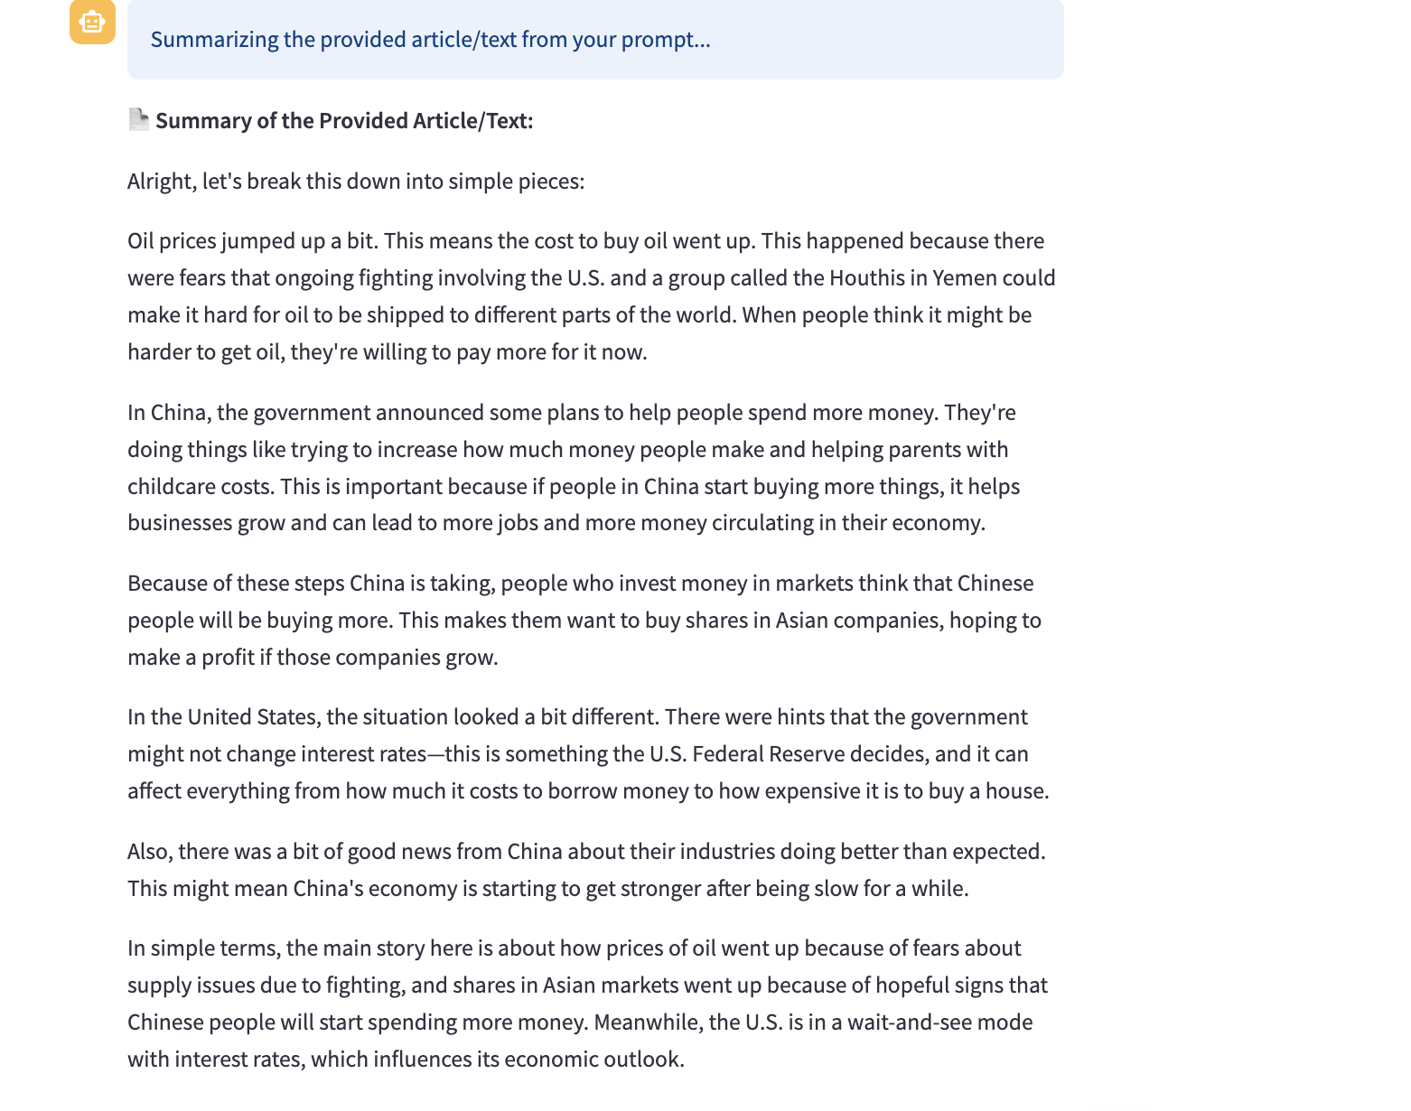
Summarization
Users can input a financial article or blog post into the chatbot for analysis.
The chatbot extracts key insights and generates a concise summary of the text.
It simplifies complex financial jargon, making the content easier to understand.
Uses OpenAI’s GPT-4 Turbo model to create an accurate and well-structured summary.
Helps users quickly grasp the core message and key takeaways of the article.
Notes:
This slide highlights the chatbot’s ability to summarize financial articles and blog posts.
Users can input any text from financial articles or blogs, and the chatbot extracts key insights.
It simplifies complex financial terms, making them more accessible.
The summarization is powered by GPT-4 Turbo agent for accuracy and coherence.
The goal is to help users quickly understand the main points and takeaways of financial content.

Slide 11
Search & Retrieval Process Overview
Embeddings Creation: Generated OpenAI text-embedding-ada-002 embeddings for all financial terms and definitions.
FAISS Indexing: Normalized the embeddings and stored them in a FAISS index to enable efficient Cosine Similarity search.
Query Embedding & Search: User queries are embedded, normalized, and searched against the FAISS index to find semantically similar terms.
Hybrid Search: Combined semantic results with keyword/exact match search to prioritize direct matches when relevant.
GPT-4 Verification: Sent top matches to GPT-4 for final selection or generation of the most accurate and user-friendly definition.
Notes:
This is an overview of how the chatbot retrieves financial data using embeddings and vector search.
We have created embeddings using OpenAI’s text-embedding model.
These embeddings are stored in a FAISS index for efficient cosine similarity searches.
The user queries are also embedded and matched against this index to find similar terminology..
Hybrid search combines keyword-based and semantic search to improve accuracy.
Finally, GPT-4 agent verifies and refines the retrieved results for easy understanding.

Slide 12
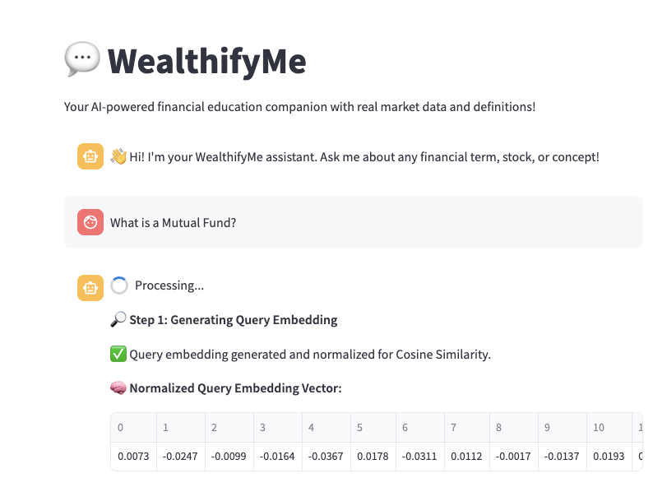
Term Definition
Generated and normalized the user query embedding using OpenAI’s text-embedding-ada-002 model to prepare it for Cosine Similarity search.
Normalization ensures accurate similarity scoring when comparing the query against the FAISS index of financial terms.
Notes:
“In this step, we’re generating an embedding for the user’s query.”
As soon as the user submits their query, for example: “What is a mutual fund?”, we send it to OpenAI’s text-embedding-ada-002 model.
This converts the query into a dense vector representation that captures its semantic meaning.
“We then normalize this query embedding.”
Normalization ensures the embedding has unit length, which is important because we’re using Cosine Similarity for matching in FAISS.
Without normalization, the similarity measure would be influenced by vector magnitude instead of pure direction.
“This step guarantees that our similarity search is accurate and consistent.”
The normalization aligns with how we indexed our financial terms in FAISS earlier (those were also normalized).
Now, both the query and the stored vectors are on the same scale, enabling a fair and accurate comparison.
“The normalized query embedding is then ready to be passed to FAISS for semantic search.”
What you see here in the screenshot is an example of a normalized query embedding vector being returned.
This is the starting point of our hybrid search process

Slide 13
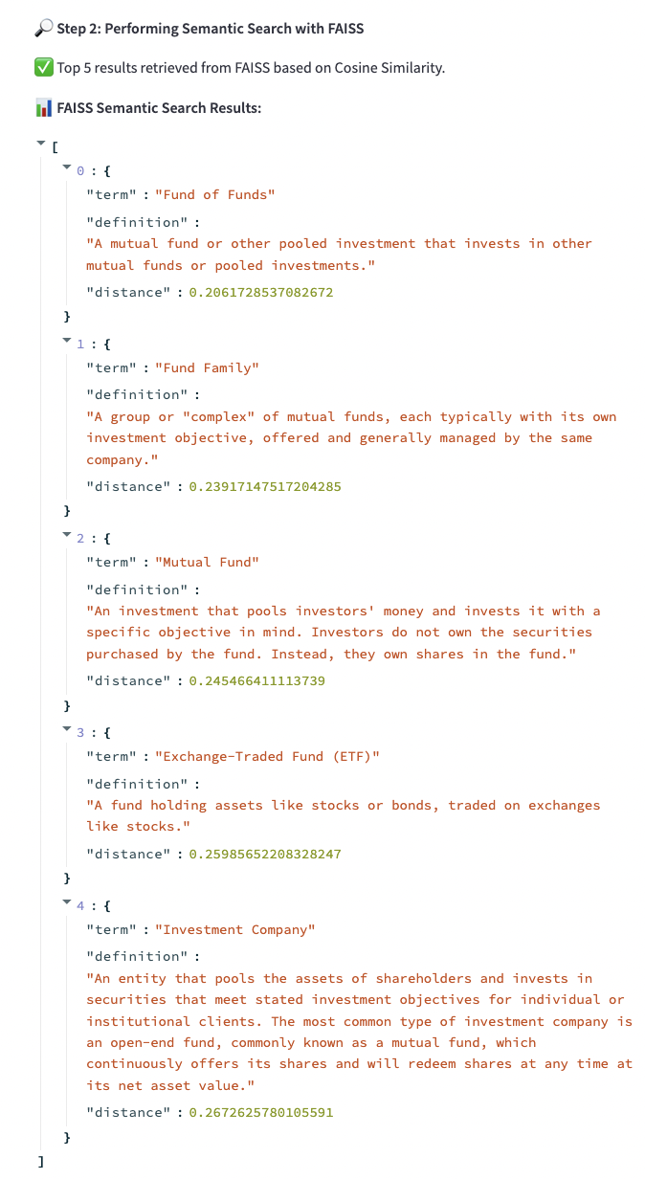
Term Definition
FAISS performs a semantic search using the normalized query embedding, retrieving the top 5 most similar terms based on Cosine Similarity.
The results are ranked by distance (lower is better), but some closely related terms may rank above the exact match due to semantic embedding variations.
Notes:
"At this stage, we’re performing a semantic search using FAISS."
The query embedding, which we generated and normalized in the previous step, is now compared against all financial term embeddings stored in our FAISS index.
"We use Cosine Similarity to measure how close each term is to the query."
Normalizing both the query and the indexed embeddings ensures the distance returned by FAISS reflects Cosine Similarity, giving us a true measure of semantic closeness.
"FAISS retrieves the top 5 most similar terms based on this similarity score."
As you can see in the debug output, each result includes the financial term, its definition, and its distance from the query.
"It’s important to note: lower distance means greater similarity."
But because embeddings capture context, sometimes related terms like Fund of Funds can rank higher than an exact match like Mutual Fund.
"This is why we later add keyword matching and GPT-4 verification to improve accuracy and relevance."

Slide 14
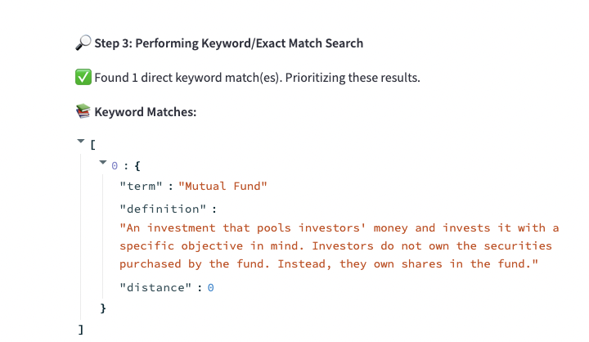
Term Definition
Performed a keyword/exact match search to detect direct matches in the query, boosting accuracy when the exact term is mentioned.
Direct matches are prioritized by assigning them a distance of zero, ensuring they appear at the top of the combined results list.
Notes:
"After performing the semantic search with FAISS, we added an additional layer: a keyword or exact match search."
This helps us catch scenarios where the user query directly mentions a term from our database—something semantic search might not always prioritize correctly.
"If we find an exact match, like in this case with 'Mutual Fund,' we assign it a distance of zero."
That ensures this result is prioritized and appears at the very top of our combined search results, even if the semantic similarity score wasn't the best.
"This hybrid approach balances semantic relevance with precision, making sure direct matches aren’t accidentally overlooked."
It makes the system smarter and more accurate, especially for straightforward queries.

Slide 15
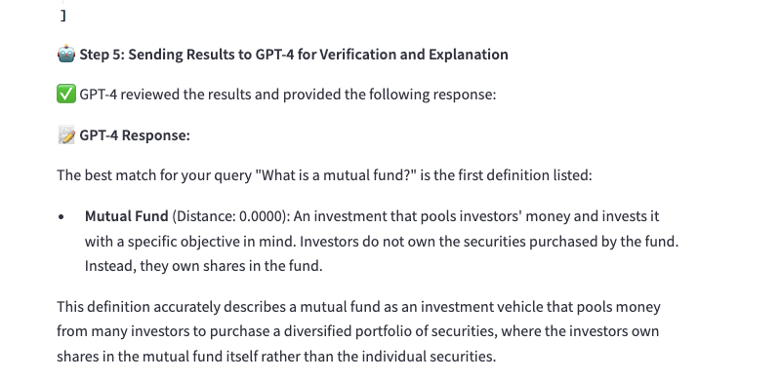
Term Definition
Send the combined search results to a GPT-4 verification agent for evaluation and final selection
The agent ensures the most accurate and user-friendly definition is chosen or generates a better one if needed
Notes:
"Once we have our combined results—both semantic search from FAISS and exact keyword matches—we send them to a GPT-4 verification agent."
This step acts as an additional quality check on top of the similarity search.
"The GPT-4 agent reviews the options and selects the most accurate and user-friendly definition."
If none of the definitions are a good fit, GPT-4 can also generate a completely new, clearer, and more tailored explanation.
"This ensures the user always gets the best answer possible, even if the initial semantic search ranks a less relevant term higher."
It's like a final expert review before showing the answer.

Slide 16
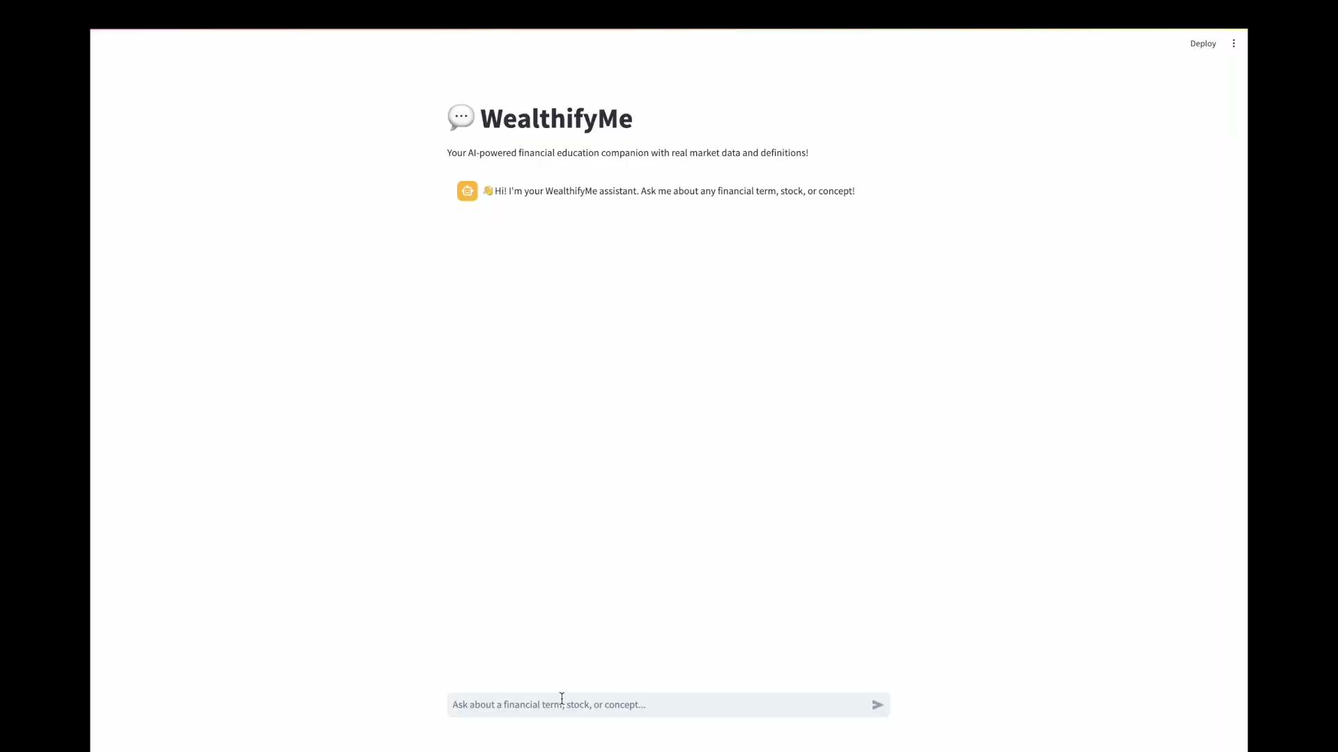
Demo
Notes:
✅ Prompt 1: "What is a Mutual Fund?"
"First, we ask What is a mutual fund?"
"WealthifyMe returns a clear, simple definition that explains how mutual funds work, in plain English."
"It even includes an easy-to-understand analogy—comparing a mutual fund to a group of friends buying fruits to help the user foster thinking
"This helps break down complex terms for users who might be new to investing."
Recommends resources and
✅ Prompt 2: "Show me market data for Microsoft."
"Next, we ask for market data on Microsoft."
"WealthifyMe pulls live data, including the current stock price, daily price change, trading volume, and a seven-day historical trend."
"The information is presented in a clean, readable format, making it easy for users to get a snapshot of the latest market activity."
✅ Prompt 3: "Compare Apple and Tesla stock."
"Now, let’s compare Apple and Tesla."
"The tool retrieves current data for both companies and provides a side-by-side comparison."
"WealthifyMe summarizes the differences in risk, returns, and typical investor profiles, helping users understand which stock might suit their strategy."
"The output makes it easy to compare investment opportunities, even for users without a finance background."
✅ Prompt 4: "Summarize this article."
"Lastly, we demonstrate summarization."
"We paste in a financial article, and WealthifyMe summarizes it in plain, simple language."
"It strips out the jargon and highlights the key points—perfect for users who want quick, digestible insights from longer reports or news articles."
✅ Tech Stack (Bullets)
Frontend
Streamlit (UI + chat interface)
Backend
Python (core backend logic)
OpenAI API
GPT-4 Turbo (intent detection, explanations, verification agent)
ADA-002 Embeddings (term + query embeddings)
FAISS (vector similarity search engine)
spaCy (Named Entity Recognition)
yFinance (real-time and historical stock data)
dotenv (environment variable management)
Data Storage
Pandas DataFrames (structured data manipulation)
CSV files (financial glossary + embeddings)
Pickle files (FAISS metadata)
FAISS Index file (vector index storage)
ML & NLP
OpenAI text-embedding-ada-002 (1536-d embeddings)
GPT-4 Turbo (verification, explanations, summarization)

Slide 17
Conclusion
$
This project successfully integrates NLP, vector search, and real-time financial data retrieval to create an intelligent chatbot, helping simplify complex financial concepts and makes them accessible to everyone.Future improvements include expanding the knowledge base, refining embeddings and ranking logic, and adding multi-lingual support to provide deeper market insights.
$
$
Notes:
This chatbot seamlessly blends advanced NLP, vector search, and real-time financial data retrieval to simplify complex financial concepts, empowering users to make well-informed decisions.
Looking ahead, we're focusing on expanding the knowledge base, refining ranking algorithms, and adding multi-lingual support to reach a global audience. Additionally, we'll introduce dynamic visualizations of financial trends to offer a more interactive experience.
Our ultimate mission is to deliver in-depth, accessible market insights, helping users navigate the financial world with ease and confidence.

Slide 18
Thank you !
$
$

